Slide 1
Google Analytics Customer Transaction Prediction
Springboard Capstone
By: Kasey Larsen

Slide 2
About the Data
The Google Merchandise Store, or GStore, is where Google swag is sold.
This data set involves customer data information for previous users and customers.
The data includes device information, geographical information, trafficking, timing, and more.

Slide 3
the Problem
Roughly 1.1% of users completed a transaction.
So how do you know where you should concentrate the marketing budget?
What features help predict whether a customer will complete a transaction?

Slide 4
Data Information
85417 entries are being analyzed from the Google Merchandise Store demo account.
The data originated from the Kaggle completion, Google Analytics Customer Revenue Prediction.
Each entry has 40 features about location, device information, and site usage.
The entries come from August 1st 2016 to April 30th 2018.

Slide 5
Exploratory Data Analysis
Important Numerical Features
Pageviews
Session Quality
Important Categorical Features
Previous Customer
Location

Slide 6
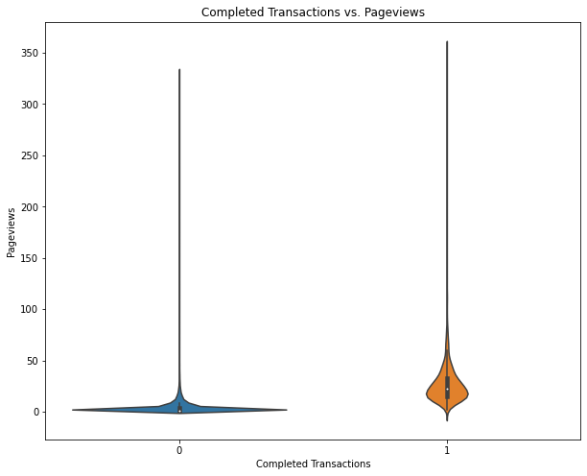
Pageviews
If a user had multiple pageviews, they were more likely to complete a transaction.

Slide 7
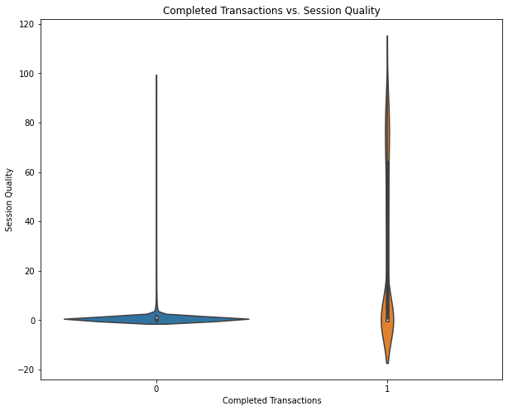
Session Quality
For users who did not complete a transaction, the session quality dim was very low. If the user did complete a transaction, the number varies.

Slide 8
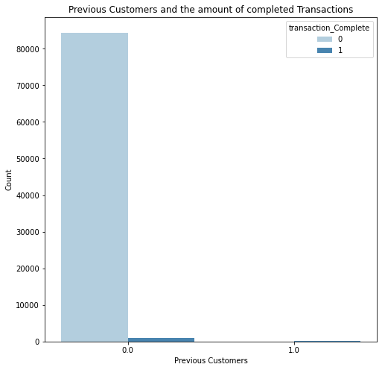
Previous Customer
All returning customers completed their transactions.

Slide 9
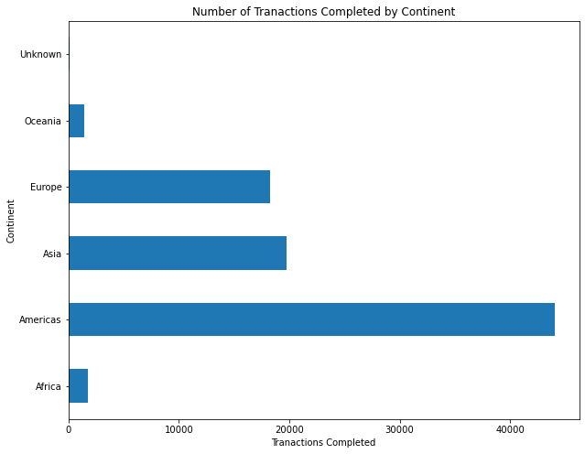
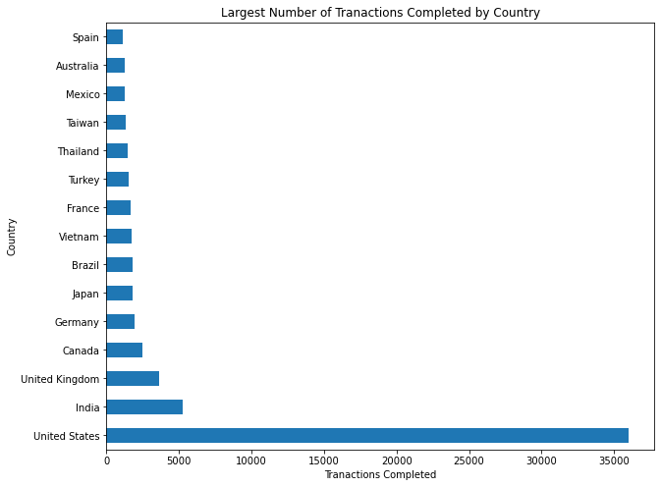
Location

Slide 10
Modeling Overview
Supervised Learning
1 indicated completed transaction
Data is highly imbalanced, so this needs to addressed

Slide 11
Modeling Process
Pre-modeling steps
Label encoding
Resampling to address imbalanced data
Splitting the data in a 70/30 train/test split
Cross validation for hyperparameter tuning
Sklearn’s RandomizedSearchCV
5-fold cv
Evaluating the model on the test data
Evaluated Accuracy, Precision, Recall and F1 scores

Slide 12
Modeling Results
 | Model | Accuracy Score | Precision Score | Recall Score | F1 Score
0 | Logistic Regession | 0.938484 | 0.943643 | 0.932572 | 0.938075
1 | Decision Tree Classifier | 0.975587 | 0.956024 | 0.996998 | 0.976081
2 | Random Forest Classifier | 0.962917 | 0.942692 | 0.985701 | 0.963717
3 | MultinomialNB | 0.812552 | 0.798723 | 0.835322 | 0.816613
4 | XGBClassifier | 0.994356 | 0.988829 | 1.000000 | 0.994383

Slide 13
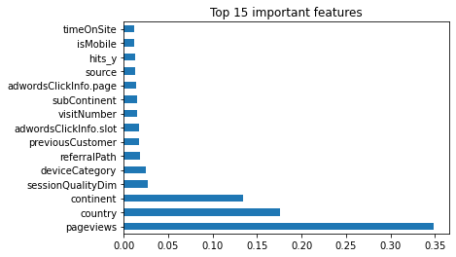
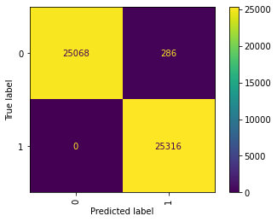
XGBClassifier Model Features

Slide 14
Using the Model
The marketing team can use the features of importance
Focus on countries that are more likely to make purchases
Start increasing ads and marketing strategies as the number of pageviews increases
Understand what features do not affect whether a user will complete a transaction.

Slide 15
Future Work
With further research, I would investigate to results of feature engineering new columns.
This could potentially create some new features of importance and help make more accurate models.

